Slide 1
Quality Improvement Methodologies
Stephanie DeLeon, MD
Monique Naifeh, MD
Mark Pogemiller, MD
Natalie Connolly, MD

Slide 2
Objectives
1. Introduce the 3 common QI methodologies: The Model for Improvement, Lean, and Six Sigma
2. Review the core properties of each method
3. Complete a lean/six sigma application exercise

Slide 3
Quality Improvement
Formal approach to the analysis of practice performance and efforts to improve that performance
In the health care system: better outcomes, greater ease of use, lower cost and more social justice
Reduction/elimination of waste, rework, and losses in the production process

Slide 4
What Production Processes are YOU are part of?

Slide 5
You Gotta Have a Goal….

Slide 6
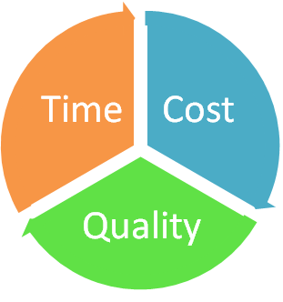
Aim Statement
What are you trying to achieve?
Must make it SMART
Measures: cost, quality, time

Slide 7
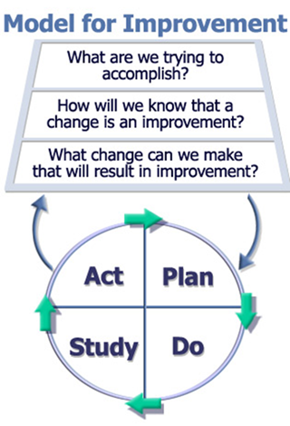
The Model for Improvement
Or…serial baseline/intervention cycles

Slide 8
PDSA Cycles
PLAN | DO | STUDY | ACT
What intervention am I going to do? What/who do I need to do it well? How will I know I’m successful? What barriers am I going to face? | Implement your change ** pilot? **all at once? | Did you make a change? What does your data show? | What did you learn from the previous 3 steps? What is your next step/intervention? What intervention will have the biggest impact?

Slide 10
Lean
To lean is to eliminate waste
Waste is determined by your customer
Waste comes in many forms:
Time
Materials
Effort

Slide 11
Where is your waste??
5M + S + Q
Man, machine, material, method, management + safety + quality

Slide 12
Lean Key Elements
Speed– how fast can you do something without cutting corners
Flexibility- can you change the type of work done quickly?
Holistic view- process is only as good as end to end flow

Slide 13
Six Sigma
Philosophy of a performance excellence standard
Less that 3.4 defects per million product
Done by reduction in variation
Everyone follows the SAME ideal process, everyone gets the same outcome
Process based, not people based

Slide 14
Six Sigma Methodology
DEFINE | MEASURE | ANALYZE | IMPROVE | CONTROL
Clearly identify your problem scope and project plan Outcome: Problem statement and project plan | Map/measure your process AS IS Collect your data Outcome: baseline data and a more focused problem statement | Study the measured data, generate theories, prioritize focus Outcome: Identify sources of variation and waste | Plan and implement systematic changes/solutions Outcome: Reduced variation and waste, improved systems | Maintain, monitor, and control implemented changes Outcome: Control plan

Slide 15
Defects
YOUR CUSTOMER DEFINES WHAT YOUR DEFECT IS!
A medical error
A late discharge
An avoidable discharge delay
Pharmacy not receiving antibiotics
A hemolyzed lab
A poorly written note
Lack of feedback
Multiple blood draws entered throughout the day instead of combined
A rescheduled MRI
Rounds lasting past 11:30

Slide 16
Side by side comparison
 | Model for Improvement | Lean | Six Sigma
Underlying philosophy | Serial intervention cycles | Eliminating waste | Eliminating variation
Timeline | Rapid cycles | Big picture | Big picture
Terminology | PDSA cycles |  | DMAIC
Potential hospital uses | Nurses inputting home pharmacy | Non working equipment Messy workroom | Hospital Rounds

Slide 17
Let’s do this!
Groups of ~6 people
Make as many star/post its as you can in 90 seconds. Must look like MINE!
Everyone in your group must have a job

Slide 18
Some possible lessons
Lean your work area
Get rid of unnecessary items/nonworking items
Lean your process
Get rid of unnecessary people
Be flexible in job assignments
**Change your work product, timeline, materials, etc

